Slide 1
LEARNING OUTCOME 3 (LO3)
Service Design & Customer Journey Mapping
Connecting end-to-end customer experiences with backstage operational capabilities.

Slide 2


CORE DEFINITIONS
Customer Journey vs. Service Design
Customer Journey
Service Design
What the customer directly experiences across sequential interactions.
How the organization orchestrates internal operations to create that experience.

Slide 3
MAPPING ANATOMY
Core Components of Journey Mapping
Actions
Emotions
Pain Points
Opportunities
Sequential steps performed during interaction.
Sentiment shifts from search to review.
Sources of delay, confusion, or friction.
Targeted interventions to enhance value.

Slide 4

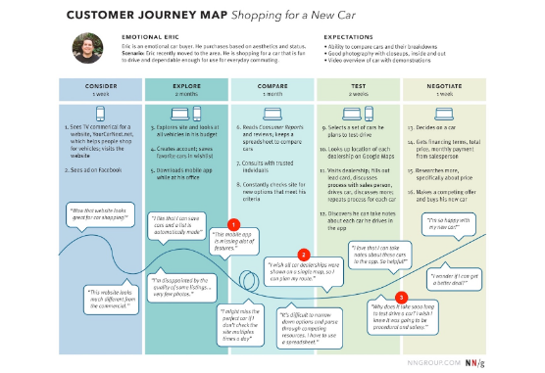
REAL-WORLD APPLICATION
Mapping an Online Food Delivery Journey
1. Restaurant Search
Friction point: Excessive unfiltered choices.
2. Waiting & Tracking
Critical vulnerability: Lack of real-time updates.
3. Delivery & Review
Delight factor: Instant 1-click feedback loop.

Slide 5
PAIN POINT OPTIMIZATION
Transforming Friction into Value
Common Friction Points
Redesign Solutions
Silent Status: Zero order notifications.
Proactive Alerts: Automated stage notifications.
Form Overload: Excessive registration fields.
Simplified Checkout: Single-click validation.
Channel Silos: Repeatedly re-entering details.
Unified Profiles: Real-time data sync.

Slide 6

PERCEPTION DRIVERS
Critical Moments of Truth
1
High-Impact Interaction
Single moments that radically alter overall brand perception.

Slide 7


INTERACTION CHANNELS
Touchpoint Classification
Digital
Physical
Human
Mobile applications, websites, live chat, self-service portals.
Retail counters, product packaging, store environments.
Support representatives, sales agents, field technicians.

Slide 8
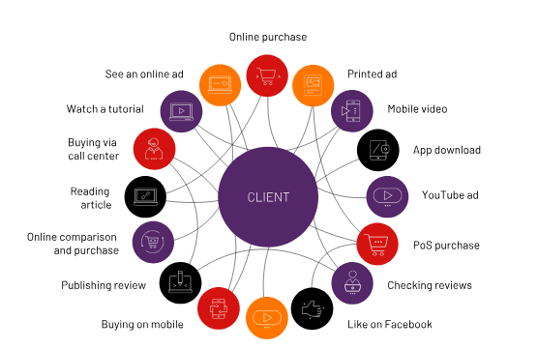
CHANNEL INTEGRATION
Multichannel vs. Omnichannel
Multichannel = Disconnected
Multiple channels operating in independent functional silos.
Omnichannel = Connected
Unified backend real-time data shared seamlessly across channels.

Slide 9

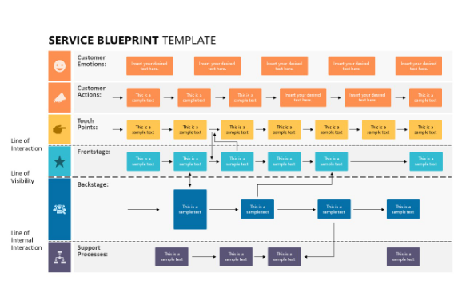
OPERATIONAL ARCHITECTURE
Frontstage vs. Backstage Blueprinting
Frontstage (Visible)
Kiosks, mobile UI, customer service staff interaction.
LINE OF VISIBILITY
Backstage (Invisible)
Inventory databases, kitchen prep systems, driver routing.

Slide 10
DIAGNOSTIC ANALYSIS
Uncovering Hidden Root Causes
Symptom Stage | Customer Perception | Backstage Root Cause
Food Delivery | "App says ready, but I'm waiting." | Manual status triggers unlinked to kitchen systems.
Hotel Check-In | "Room unavailable at 2 PM." | Housekeeping app disconnected from PMS status.
Retail Store | "Stock listed online missing in store." | Batch inventory updates instead of real-time sync.

Slide 11
LO3 FRAMEWORK
The Service Improvement Formula
01
02
03
04
JOURNEY
BLUEPRINT
TOUCHPOINT
IMPROVE
Map end-to-end customer actions.
Audit internal operations.
Connect omni-channel nodes.
Eliminate friction points.

Slide 12
SUMMARY & CONCLUSION
Seamless Frontstage Starts with Integrated Backstage Systems
Mastering LO3 requires evaluating both the emotional customer path and operational backstage workflows.
Q&A / Classroom Case Study Discussion

Slide 13




Image Sources
https://media.nngroup.com/media/editor/2020/02/24/carjourneymap-4highfrictiontransitions.jpg
Source: www.nngroup.com
https://cdn.prod.website-files.com/63613a90d07eba0c29ca25cf/69fca9b5b94bd43520c34774_man-tourist-carrying-baggage-lobby-entering-hotel-reception-.jpg
Source: www.bookboost.io
https://www.univio.com/wp-content/uploads/2024/01/customer_lifecycle_EN.svg
Source: www.univio.com
https://slidemodel.com/wp-content/uploads/21359-01-service-blueprint-powerpoint-template-16x9-1.jpg
Source: slidemodel.com

